Slide 1


Cloth-Changing Person Re-identification
From A Single Image with
Gait Prediction and Regularization
Xin Jin, Tianyu He, Kecheng Zheng, Zhiheng Yin, Xu Shen, Zhen Huang, Ruoyu Feng, Jianqiang Huang, Zhibo Chen, Xiansheng Hua
CVPR 2022
Presenter:许一凡
Date:2023.9.15

Slide 2
Contents
A brief introduction of person ReID
Paper sharing: Cloth-Changing Person Re-identification
from A Single Image with Gait Prediction and Regularization

Slide 3
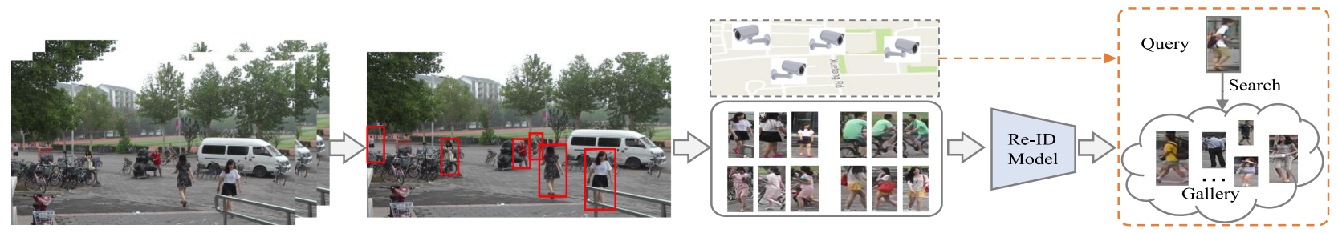
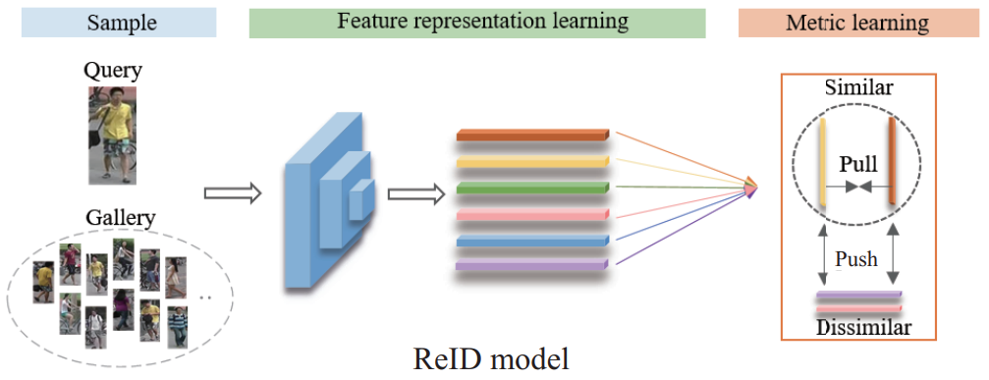
A brief introduction of person ReID
General ReID
Standard Person ReID flow
Raw Data Collection
Bounding Box Generation
Training Data Annotation
Model Training
Pedestrian Retrieval
[1] 赵才荣, 齐鼎, 窦曙光, 等. 智能视频监控关键技术: 行人再识别研究综述. 中国科学: 信息科学, 2021, 51: 1979–2015, doi: 10.1360/SSI-2021-0211
[2] M. Ye, J. Shen, G. Lin, T. Xiang, L. Shao and S. C. H. Hoi, "Deep Learning for Person Re-Identification: A Survey and Outlook," in IEEE Transactions on Pattern Analysis and Machine Intelligence, vol. 44, no. 6, pp. 2872-2893, 1 June 2022, doi: 10.1109/TPAMI.2021.3054775.

Slide 4
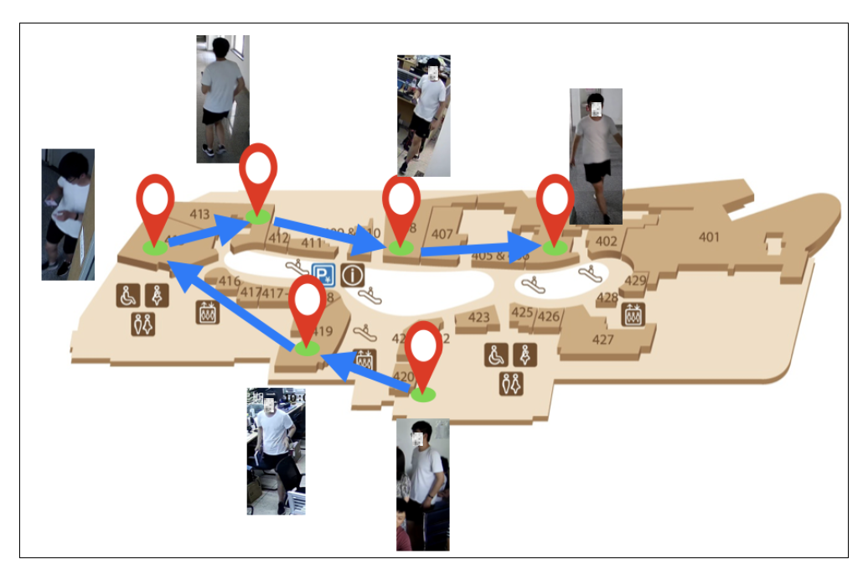
A brief introduction of person ReID
General ReID
Open-Set Person ReID
Occluded
Unsupervised
Virtual Data
Domain Generalization
Cloth-Changing
Cross Modality
Person Search
Generate a person tracklet
[1] 张永飞，杨航远，张雨佳，豆朝鹏，廖胜才，郑伟诗，张史梁，叶茫，晏轶超，李俊杰，王生进. 2023. 行人再识别技术研究进展. 中国图象图形学报，28（06）：1829-1862

Slide 5
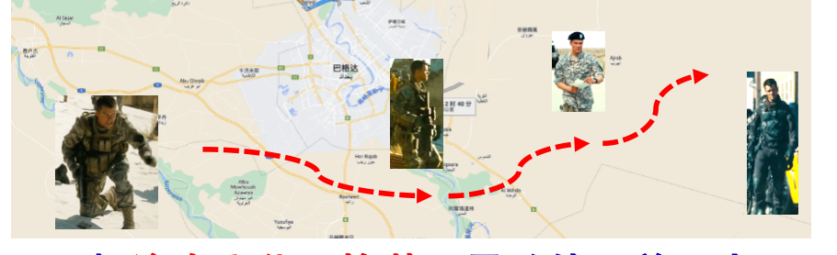
A brief introduction of person ReID
Cloth-Changing Person ReID
An actual example of cloth-changing person ReID
Main-stream methods for cloth-changing person ReID
Explicitly introducing feature extraction methods unrelated to clothing clues (FSAM、GI-ReID etc.)
Feature decoupling method for clothing information and identity information (CAL、SirNet etc.)

Slide 6
Contents
A brief introduction of person ReID
Paper sharing: Cloth-Changing Person Re-identification
from A Single Image with Gait Prediction and Regularization

Slide 7
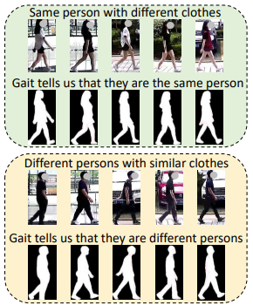
Paper sharing
Introduction → Method → Experiments → Conclusion
Task: Utilize gait prediction and regularization to assist cloth-changing person ReID under image-based scenarios
Problems
Chanllenges
Existing methods using contour or body shape suffers from estimation error, single-view inference from 2D image is extremely difficult
Existing gait-related studies mainly rely on large video sequences, the latency and storage are undesirable for real-time ReID
Solution
Address CC-ReID from a single image with gait prediction and regularization
Only focus on static spatial cues from persons, the rich dynamic motion information like gait are often ignored
Potential viewpoint-variations and occlusions makes leverage gait feature challenging
Gait information could help ReID

Slide 8
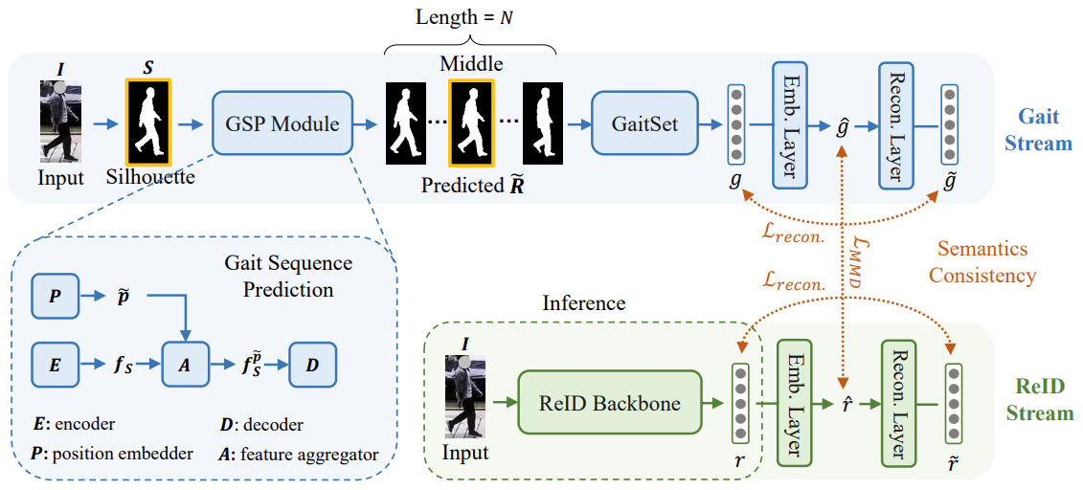
Paper sharing
Introduction → Method → Experiments → Conclusion
Overview of the proposed GI-ReID

Slide 9
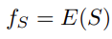
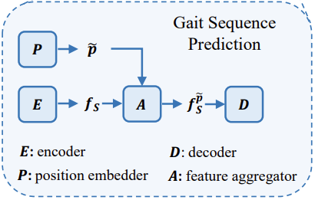
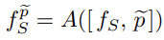
Paper sharing
Introduction → Method → Experiments → Conclusion
The auxiliary Gait-Stream: Gait Sequence Prediction(GSP) Module
I. Encoder E:
Structure: [Conv. Layer(filter size = 4 x 4, stride = 2), BN Layer, ReLU activation function] x 4 + FC Layer → 100-dimension feature
II. Position Embedder P:
Structure: similar to E, with one more FC Layer→ 1-dimension feature
III. Feature Aggregator A:
Structure: concatenation + FC Layer→ 100-dimension feature
IV. Decoder D:
Structure: symmetrical to E → N x h x w silhouettes
[1] Chi Xu, Yasushi Makihara, Xiang Li, Yasushi Yagi, and Jianfeng Lu. Gait recognition from a single image using a phase-aware gait cycle reconstruction network. ECCV 2020.

Slide 10
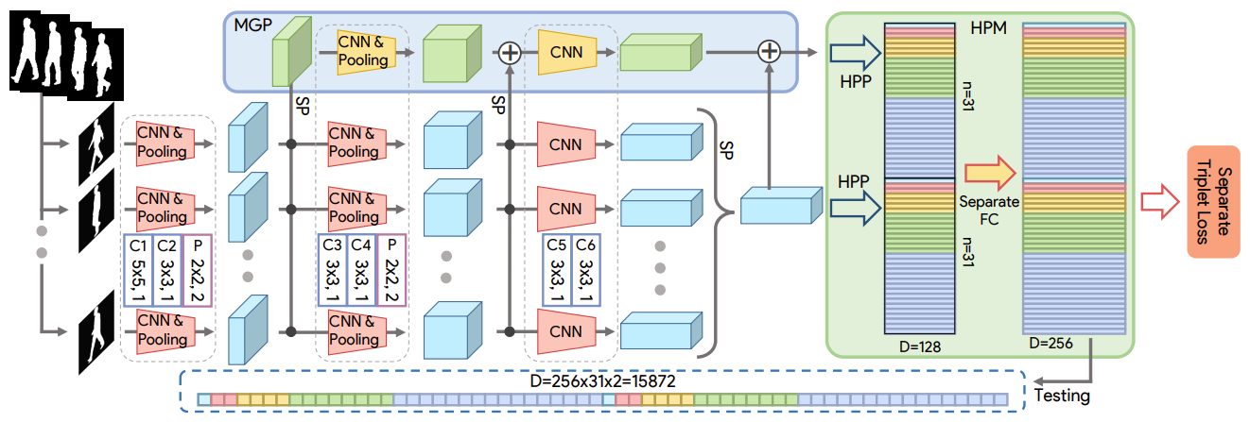
Paper sharing
Introduction → Method → Experiments → Conclusion
The auxiliary Gait-Stream: Gait Feature Extraction
The framework of GaitSet
[1] Hanqing Chao, Yiwei He, Junping Zhang, and Jianfeng Feng. Gaitset: Regarding gait as a set for cross-view gait recognition. In AAAI, volume 33, pages 8126–8133, 2019.

Slide 11
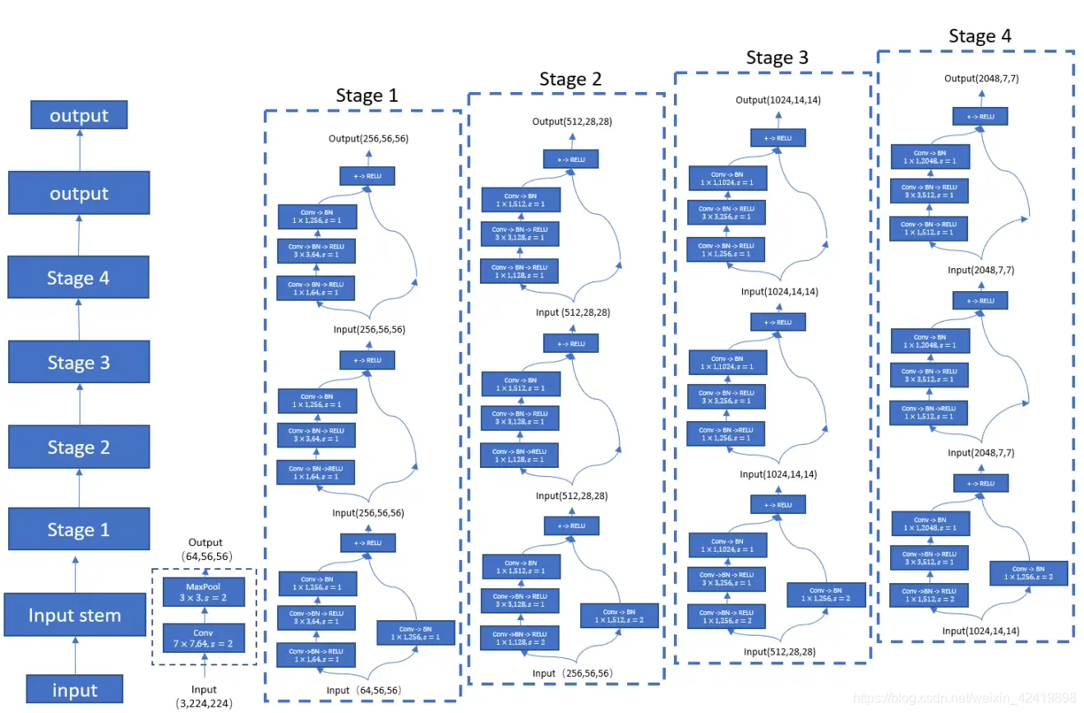
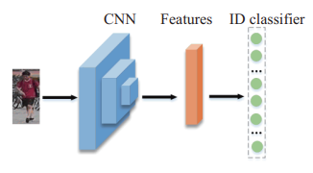
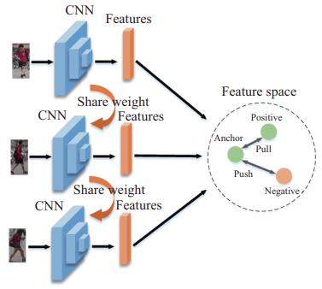
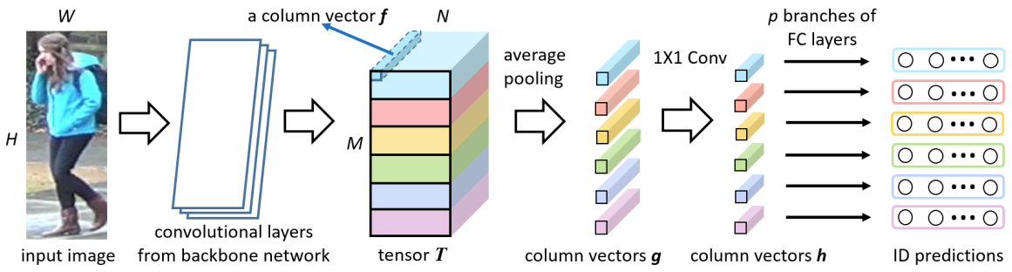
Paper sharing
Introduction → Method → Experiments → Conclusion
The main ReID-Stream
ReID Backbone: any of the off-the-shelf networks
Loss function
Classification Loss
ResNet50
Triplet Loss
PCB

Slide 12
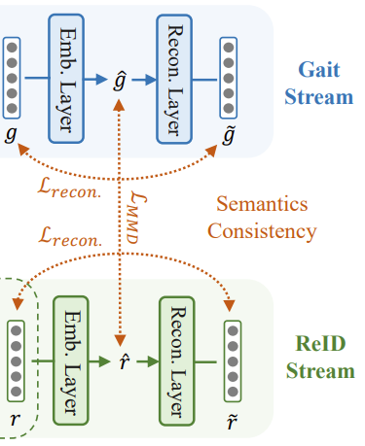
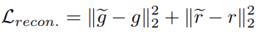
Paper sharing
Introduction → Method → Experiments → Conclusion
Joint Learning of Two Streams: Semantics Consistency Constraint
I. Embedding: enforce the transformed features and to be closed to each other by minimizing the Maximum Mean Discrepancy (MMD)
Original formula:
Empirical approximation:
II. Reconstruction: avoid the information lost caused by feature regularization with SC constraint
ensure the transformed features could be recovered to original versions
→

Slide 13
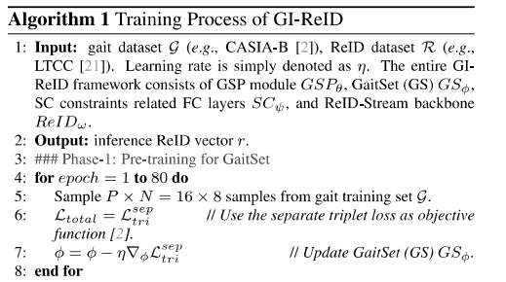
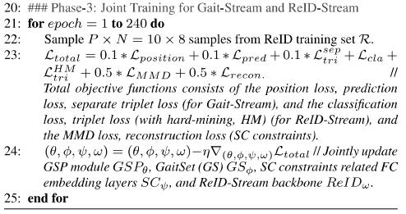
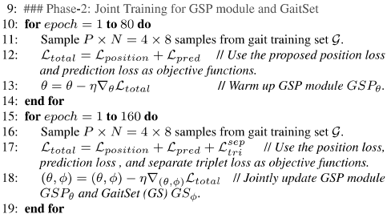
Paper sharing
Introduction → Method → Experiments → Conclusion
Joint Learning of Two Streams: Training Algorithm
II. Joint Training for GSP module and GaitSet
III. Joint Training for Gait-Stream and ReID-Stream
I. Pre-training for GaitSet

Slide 14
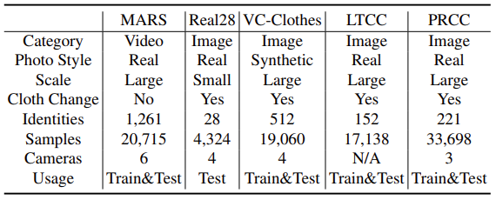
Paper sharing
Introduction → Method → Experiments → Conclusion
Datasets, Metric and Experimental Setups
Evaluation Metrics: Rank-N and mAP
Experiment settings:
Real Cloth-Changing Image ReID
General Video ReID
Imitated Cloth-Changing Video ReID
Brief introduction and comparison of datasets

Slide 15
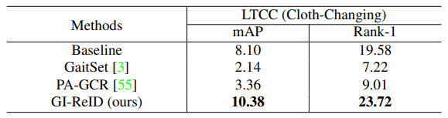
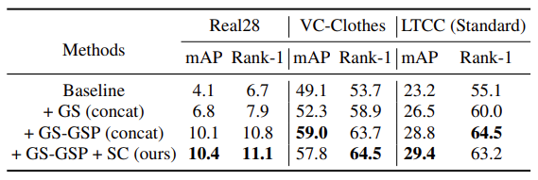
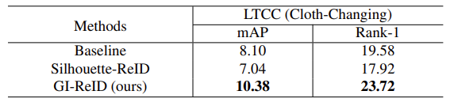
Paper sharing
Introduction → Method → Experiments → Conclusion
Ablation Study
Study on Directly Using Gait Recognition Methods for Cloth-Changing ReID
Results of Real Cloth-Changing Image ReID
Improvement Comes From Gait Prediction, Not Silhouettes Usage

Slide 16
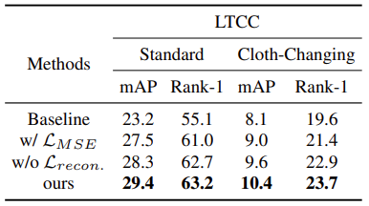
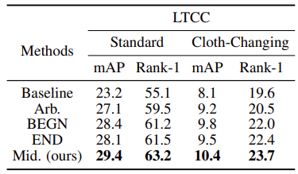
Paper sharing
Introduction → Method → Experiments → Conclusion
Design Choices in Our GI-ReID Framework
Study on the used losses in SC constraint
Study on the input gait position p in GSP
Why Use MMD for Regularization?
&
Is Reconstruction Penalty Necessary?
Is ‘Middle Frame Input Principle’ Necessary?

Slide 17
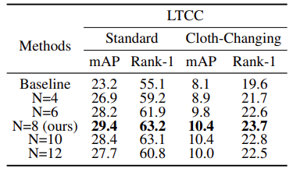
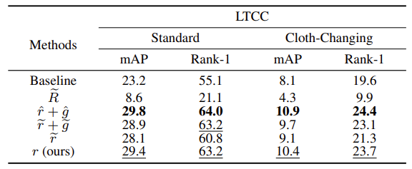
Paper sharing
Introduction → Method → Experiments → Conclusion
Design Choices in Our GI-ReID Framework
Study on the gait prediction length N
Study on the different ReID inference strategies
Which One for ReID Inference?

Slide 18
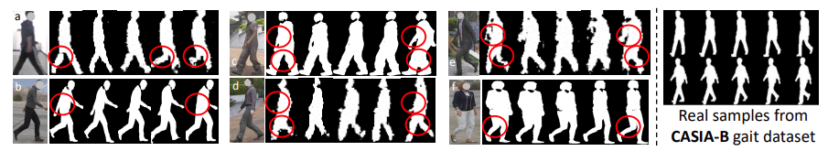
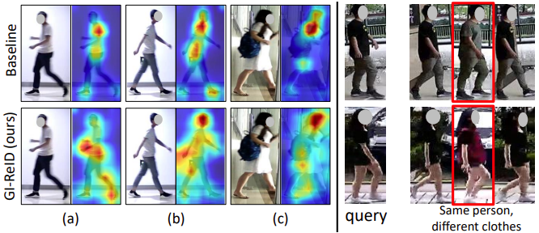
Paper sharing
Introduction → Method → Experiments → Conclusion
More Analysis and Visualization
Six predicted gait sequences
vs.
realistic gait samples
Three examples of activation maps comparison
&
Top-3 ranking list of GI-ReID for two query images on Real28

Slide 19
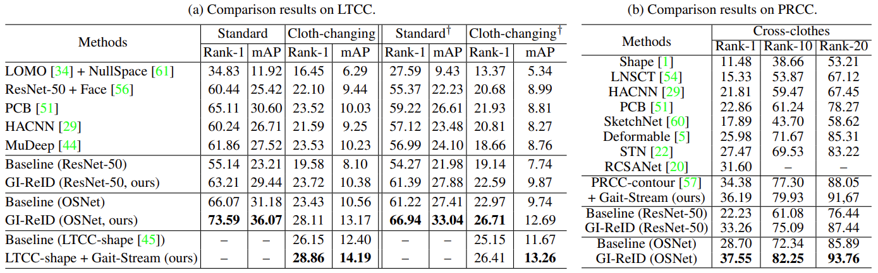
Paper sharing
Introduction → Method → Experiments → Conclusion
Comparison with State-of-the-Arts

Slide 20
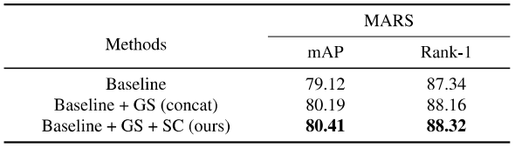
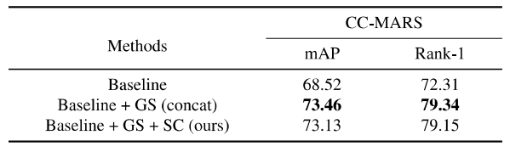
Paper sharing
Introduction → Method → Experiments → Conclusion
Under Other Two Settings
General Video ReID
Imitated Cloth-Changing Video ReID

Slide 21
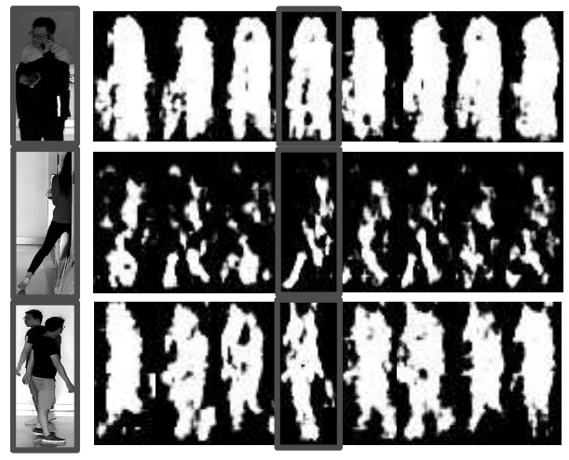
Paper sharing
Introduction → Method → Experiments → Conclusion
Failure Cases
Failure Reasons: occlusion, partial, multi-person

Slide 22
Paper sharing
Introduction → Method → Experiments → Conclusion
Contributions
Design a Gait Sequence Prediction(GSP) module, making person ReID more efficient under image-based ReID scenarios.
Apply a high-level semantics consistency(SC) constraint, enabling an effective regularization between two streams.
Remained Problems
Slight discrepancy in human gait leads to difficulty in discrimination.
The performance depends on extra/auxiliary information quality.
Lacking explicit comparison of inference time when deciding which feature vectors should be chosen for inference

Slide 23
The End
Thank you for watching!
Presenter:许一凡
Date:2023.9.15

